Slide 1


ENERGY
SOURCES OF
THE WORLD!

Slide 2










Did you know there are at least
12 energy sources?
Natural Gas
Petroleum
Propane
Hydroelectric
Hydrogen
Biomass
Ethanol
Solar
Geothermal
Coal
Wind
Nuclear

Slide 3
Each energy source is either renewable or nonrenewable!
^{RENEWABLE}
^{NONRENEWABLE}
ENERGY
SOURCES OF
THE WORLD!

Slide 4
Renewable Energy Sources
Renewable resources can be replenished at a comparable rate to the rate of consumption. Energy sources like hydroelectric power, solar energy, and wind power are considered “perpetual resources” because they run no risk of depletion.
^{RENEWABLE}
ENERGY
SOURCES OF
THE WORLD!

Slide 5
Nonrenewable Energy Sources
Nonrenewable resources are energy sources like petroleum, propane, natural gas, coal, and nuclear energy that take millions of years to form and cannot be regenerated in a short period of time.
^{NONRENEWABLE}
ENERGY
SOURCES OF
THE WORLD!

Slide 6
Which energy source
is the best?
Although oil, natural gas, and coal will
remain the primary energy sources for the foreseeable future, a variety of resources
will be needed to meet the world’s growing demand. All energy sources have benefits,
as well as challenges to overcome.
ENERGY
SOURCES OF
THE WORLD!

Slide 7
Costs to Consider!
How much will it cost to set-up and operate?
Does the energy source require storage and will the final product be too expensive?
Can it be produced on a large scale?
How will the production of the energy source impact the environment?
ENERGY
SOURCES OF
THE WORLD!

Slide 8

PETROLEUM
PETROLEUM is formed from animals and plants that lived
millions of years ago when heat and pressure turned decayed matter into crude oil.
 | Transportation fuel for the world Basis of many products, from prescription drugs to plastics Economical to produce, easy to transport
 | High C0₂ emissions Found in limited areas Supply may be exhausted before natural gas/coal resources Possible environmental impact from drilling and transporting
PROS
CONS
nonrenewable

Slide 9
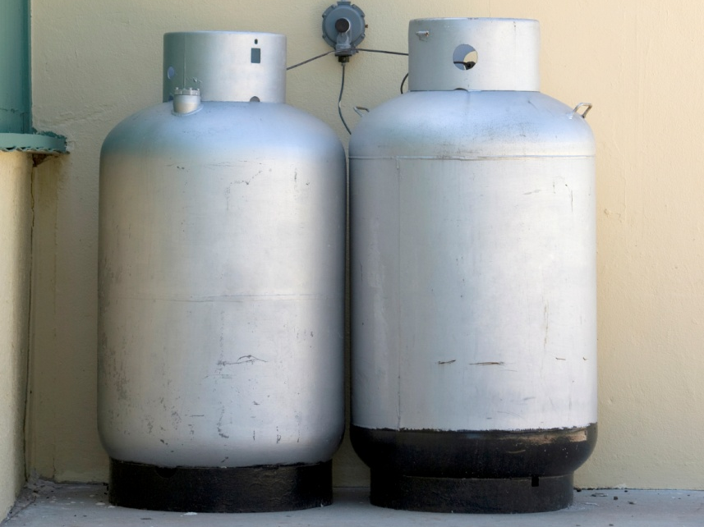
PROPANE
PROPANE is produced as a byproduct from natural gas
processing and crude oil refining. It burns hotter and more
evenly than other fuels.
 | Yields 60–70% less smog-producing hydrocarbons than gasoline/diesel fuel or propane exhaust Nontoxic and insoluble in water Doesn’t spill, pool, or leave a residue
 | Uses some fossil fuels in conversion Highly flammable Less energy in a gallon of propane than in a gallon of gasoline or diesel fuel
PROS
CONS
nonrenewable

Slide 10
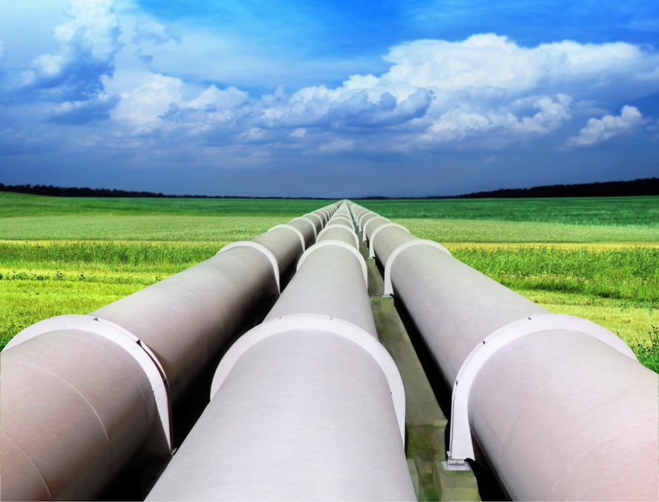
NATURAL GAS
NATURAL GAS consists primarily of methane but includes significant quantities of ethane, butane, propane, carbon dioxide, nitrogen, helium, and hydrogen sulfide.
 | Widely available Burns more cleanly than coal or oil Often used in combination with other fuels to decrease pollution in electricity generation Added artificial odor that people can easily smell the gas in case of a leak
 | Transportation costs are high Burns cleanly, but still has emissions Pipelines impact ecosystems
PROS
CONS
nonrenewable

Slide 11
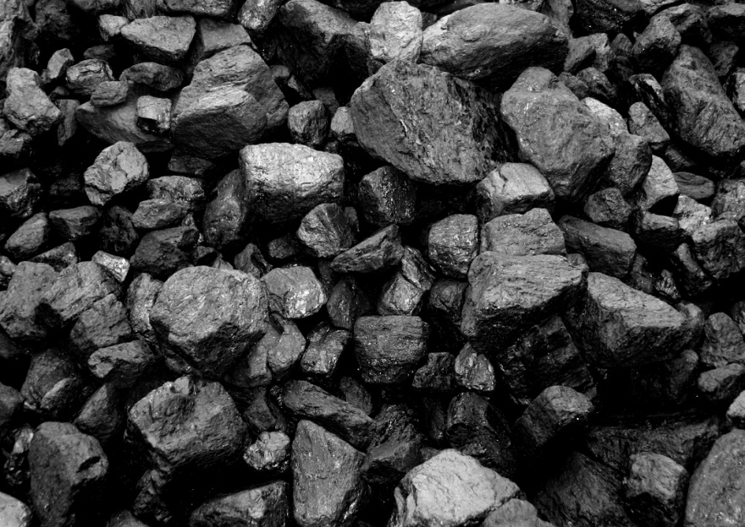
COAL
COAL is formed from trees and plants in vast primeval forests, when heat and pressure turned decayed matter into coal. Coal
is a part of the fossil fuels family.
 | Abundant supply Currently inexpensive to extract Reliable and capable of generating large amounts of power
 | Emits major greenhouse gases and acid rain High environmental impact from mining and burning Mining can be dangerous for miners
PROS
CONS
nonrenewable

Slide 12
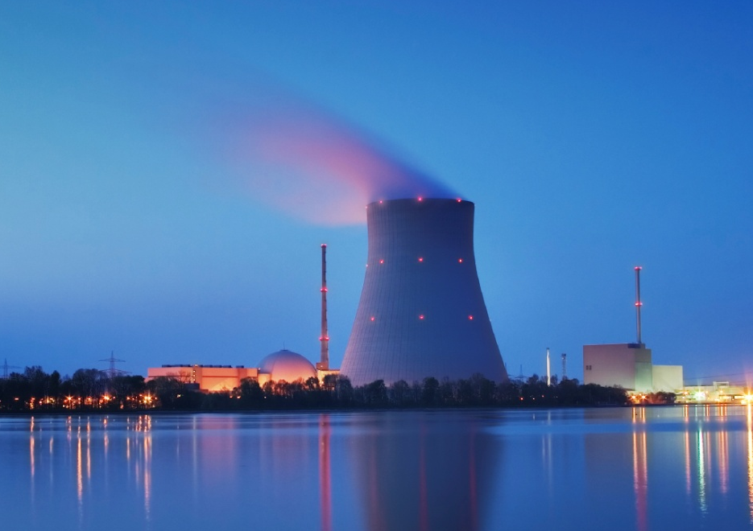
NUCLEAR ENERGY
NUCLEAR ENERGY is generated in reactors, when nuclear
fuel fission heats water, and the steam turns turbines to run
the generators that convert energy into electricity.
 | No greenhouse gases or C0₂ emissions Efficiently transforms energy into electricity Uranium reserves are abundant Refueled yearly
 | Higher capital costs Problem of long-term storage of radioactive waste Heated waste water from nuclear plants harms aquatic life Potential nuclear proliferation issue
PROS
CONS
nonrenewable

Slide 13

SOLAR ENERGY
SOLAR ENERGY is generated when photovoltaic (PV)
cells convert heat from the sun directly into electricity.
 | Nonpolluting Most abundant energy source available Systems last 15–30 years
 | High initial investment Dependent on sunny weather Supplemental energy may be needed in low sunlight areas Requires large physical space for PV cell panels
PROS
CONS
renewable

Slide 14
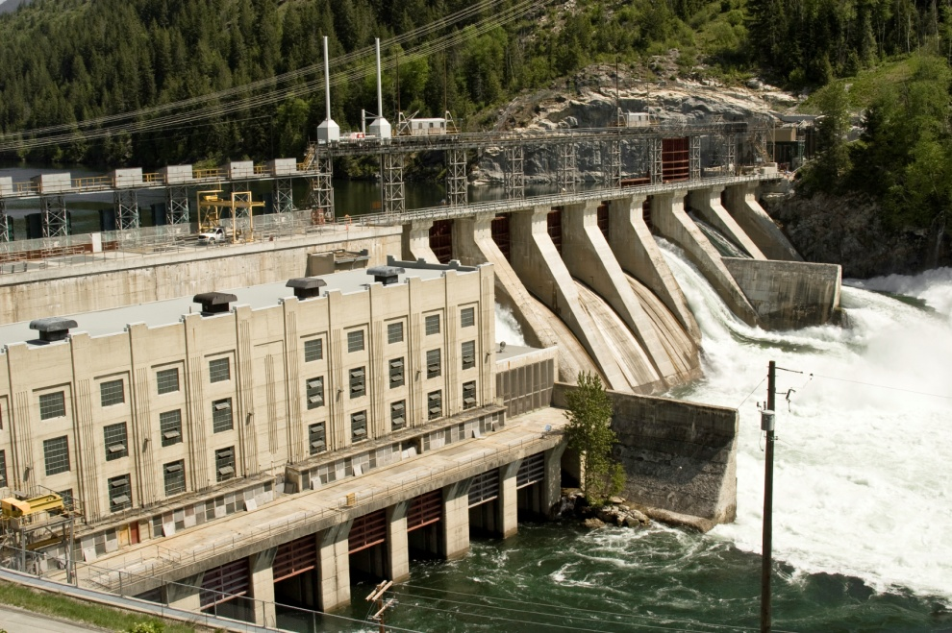
HYDROELECTRIC
HYDROELECTRIC POWER is generated when flowing water
turns turbines to run generators that convert energy into electricity.
 | No emissions Reliable Capable of generating large amounts of power Output can be regulated to meet demand
 | Environmental impacts by changing the environment Hydroelectric dams are expensive to build Dams may be affected by drought Potential for floods
PROS
CONS
renewable

Slide 15
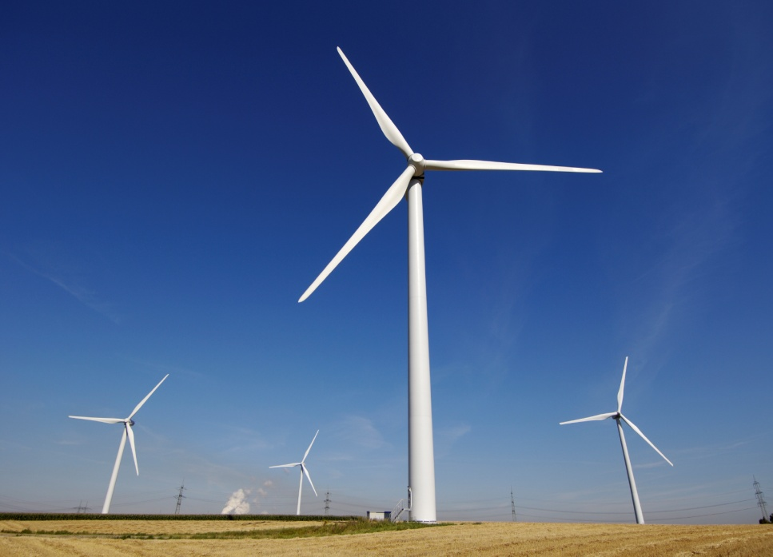
WIND POWER
WIND POWER is generated when wind turns turbines to run
the generators that convert energy into electricity, which is
then stored in batteries.
 | No emissions Affordable Little disruption of ecosystems Relatively high output
 | Output is proportional to wind speed Not feasible for all geographical locations High initial investment Extensive land use
PROS
CONS
renewable

Slide 16

BIOMASS
BIOMASS is produced from vegetable oils, animal fats, recycled restaurant greases, and other byproducts of plant, agricultural,
and forestry processing or industrial and human waste products.
 | Abundant supply Fewer emissions than fossil fuel sources Can be used in diesel engines Auto engines can easily be converted to run on biomass fuel
 | Source must be near usage to cut transportation costs Emits some pollution Increases nitrogen oxides, an air pollutant emissions Uses some fossil fuels in conversion
PROS
CONS
renewable

Slide 17
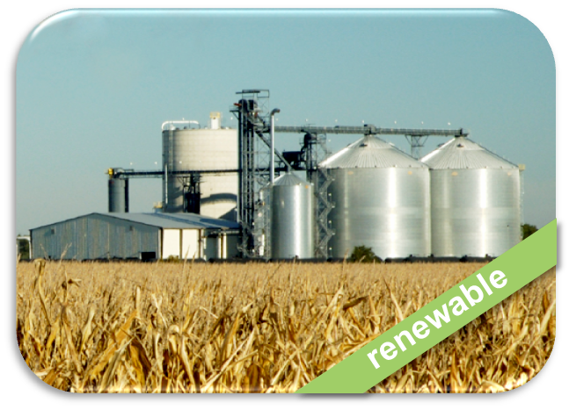
ETHANOL
ETHANOL is a subset of biomass that is manufactured from alcohols, ethers, esters, and other chemicals extracted from
plant and tree residue. It can be made from corn, sugar,
wheat, and barley.
 | Easily manufactured Fewer emissions than fossil fuel Carbon-neutral (C0₂ emissions offset by photosynthesis in plants)
 | Extensive use of cropland Less energy in a gallon of ethanol than in a gallon of gasoline or diesel fuel Costs more than gasoline to produce Currently requires government subsidy to be affordable to consumers
PROS
CONS

Slide 18
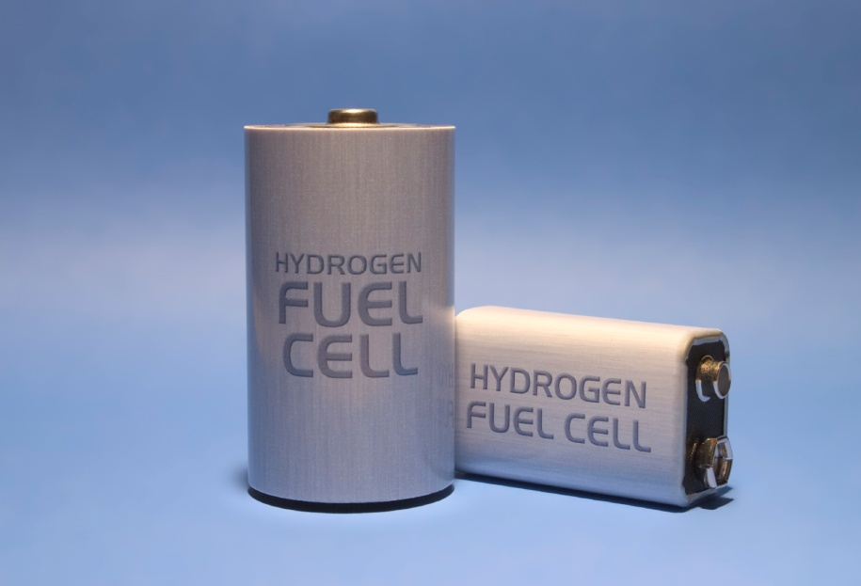
HYDROGEN
HYDROGEN is found in combination with oxygen in water, but it
is also present in organic matter such as living plants, petroleum,
or coal. Hydrogen fuel is a byproduct of chemically-mixing hydrogen and oxygen to produce electricity, water, and heat. It’s stored in
a “cell” or battery.
 | Abundant supply Water vapor emissions only Excellent industrial safety record
 | More expensive to produce than fossil fuel Systems Currently uses a large amount of fossil fuels in the hydrogen extraction process Storage and fuel cell technology still being developed
PROS
CONS
renewable

Slide 19
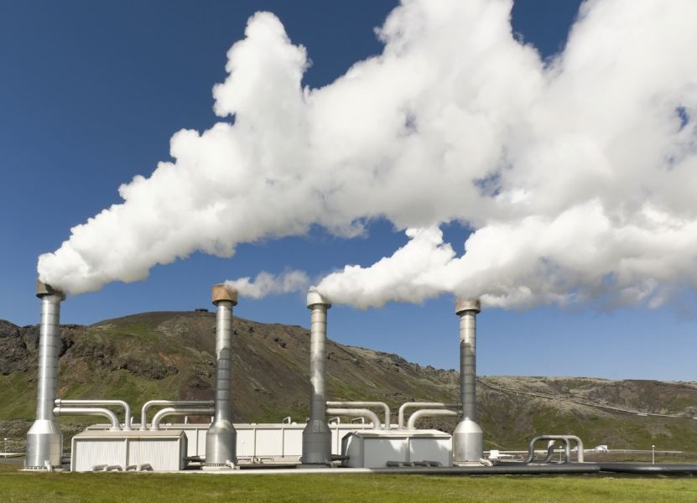
GEOTHERMAL
GEOTHERMAL ENERGY is generated by heat in the earth’s
core. It is found underground by drilling steam wells (like oil drilling). There is a global debate as to whether geothermal
energy is renewable or nonrenewable.
 | Minimal environmental impact Efficient Power plants have low emissions Low cost after the initial investment
 | Geothermal fields found in few areas around the world Expensive start-up costs Wells could eventually be depleted
PROS
CONS
nonrenewable
renewable

Slide 20
ENERGY
SOURCES OF
THE WORLD!

