Slide 1
Energy4me Activities
SPE Member Training

Slide 2
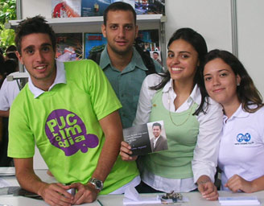
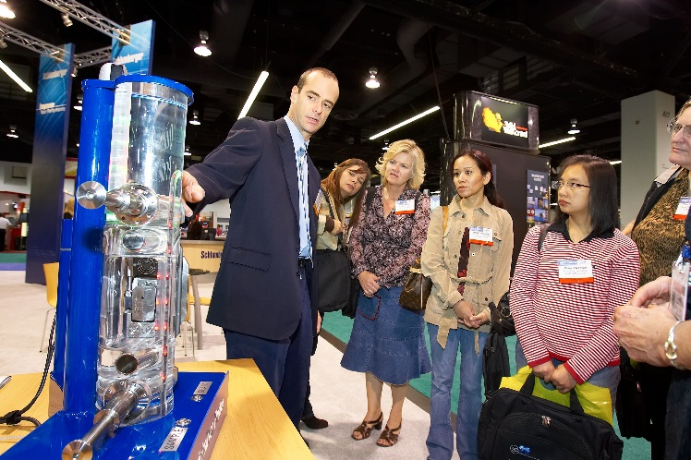
Energy4me
SPE encourages its members to help educate the public about energy and put a face on the industry.
Energy is a critical issue worldwide, and SPE believes face-to-face contact is the ideal way to spread the word about energy conservation, the future of the oil and gas industry and its impact on the planet.
SPE’s energy4me program is designed to help make an impact with website resources, speaker programs, teacher development, and STEM student workshops.

Slide 3
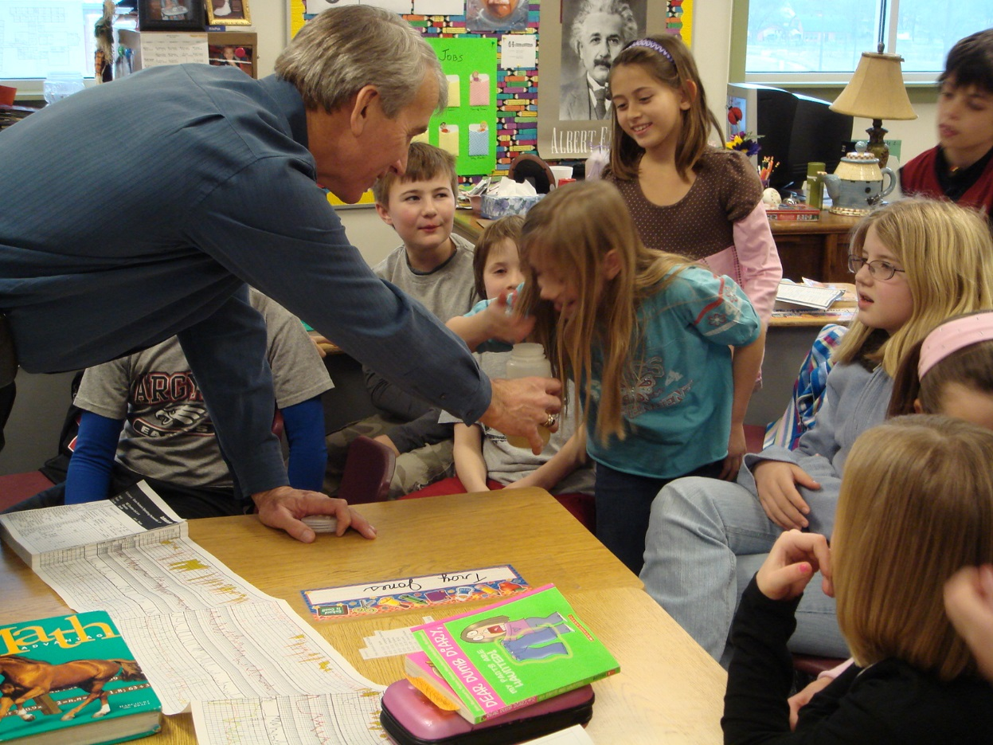
How to conduct Energy4me presentations
Students and teachers welcome professional for classroom presentations and it is a great way to help your community.
Energy4me offers:
  Activities to do with the students
  Books for the classroom
  Career videos
Tips for a successful visit
  Make it hands-on—estimate 25-30 students (check with teacher prior).
  Bring enough for students to work in groups of 4 or 5
Suggested agenda
  10 min industry overview (if it is upper level students add career opportunities)
  20 min Pick one activity (depending on time)
  10 Q&A
Bring something from your office or university for show and tell (core sample, seismic map etc.)

Slide 4


Slide 5
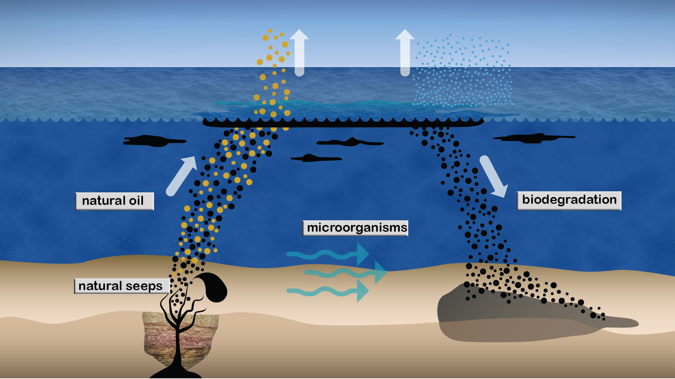
Oil Seeps
Oil and gas seeps are natural springs where liquid and gaseous hydrocarbons leak out of the ground.
These seeps are fed by natural underground accumulations of oil and natural gas. Oil that leaks to the Earth’s surface looks tar-like due to evaporation of lighter components over time.
This activity models the formation and process of oil seeps. After the activity, discuss how density of oil and Earth’s materials contribute to the process and any modifications that could be made to the model.

Slide 6
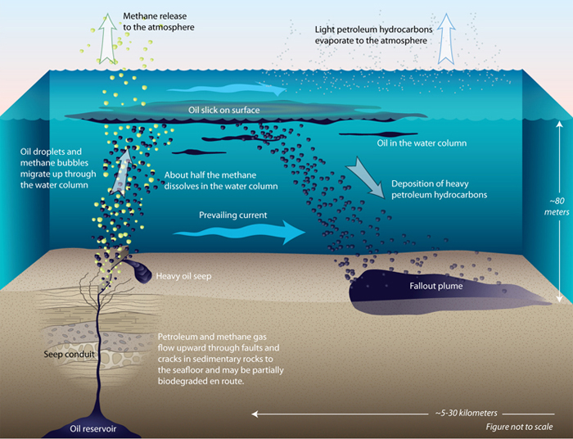
Oil Seeps
Supplies
1 Large clear glass
1 Small mixing bowl
2 mL of cooking oil
10 cm³ of sand
30 cm³ of soil
1 piece of clay
Water

Slide 7
Oil Seeps
Instructions
1. Pour sand into bottom of the glass.
2. Pour the oil into the sand and add 1 mL of water.
3. Mix the soil with water until it is very wet, then pack tightly into the glass on top of the sand mixture.
4. Flatten the clay into a circle as large as the opening of the glass.
5. Make a thin seal over the soil with the clay.
6. Fill the glass with water.
7. Observe the surface of the water to see how long it takes the oil to seep through the layers to the top of the water.
8. If seeping doesn’t occur after 10 minutes, agitate the sides of the container to accelerate the seep effect.
9. Record observations.

Slide 8
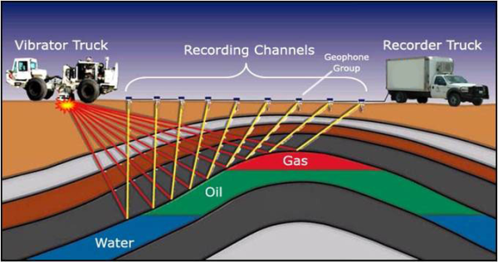
Sound Waves
Seismic is a technology that bounces sound waves off rock formations deep below the surface of the earth to provide explorers with a picture of the subsurface, often revealing locations where oil and gas may be trapped.
Seismic relies on a process in which sound generated at the surface travels into the earth, hits a rock formation and then bounces back to devices that record the echo.
The time it takes the sound to bounce back to the receiver is related to the depth of that rock formation. When thousands of these echoes are recorded over time, they create a picture of the rocks beneath our feet.
This activity explores the behavior of sound waves. After the activity, discuss with students how to test how sound travels through different types of rock.

Slide 9
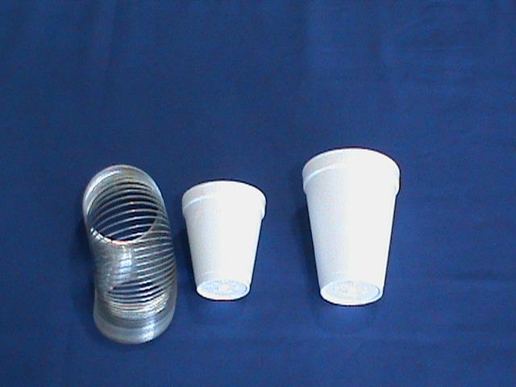
Sound Waves
Supplies
1 Metal slinky spring
1 Large foam cup
1 Small foam cup

Slide 10
Sound Waves
Instructions
Place the slinky on the floor so the coils are all together facing up. Place the large foam cup inside of the slinky coils and press in gently.
Lift the cup straight up. The end coils should come up around the center of the cup.
Place your hand around a few coils in the cup’s middle to hold the slinky in place.
Bounce your hand up and down to create longitudinal waves and observe the sound vibrations echoing from the cup.
Repeat your hand motions at different heights—low and high—to hear the different sound vibrations and see the longitudinal waves produced.
Remove the large cup and repeat the investigation with the small cup.

Slide 11
Core Sampling
Core sampling is one way that geologists determine the geologic formation of rocks and sediments when exploring for oil and gas.
Some students will hit rock and find it difficult to continue. Relate this to real-world drilling and why drill bits are used to churn up and break up rock in the sampling path.
This activity demonstrates the different ways sediments and rocks are formed in layers.

Slide 12
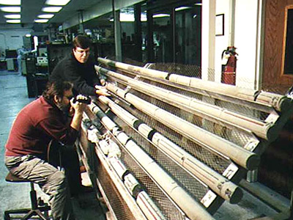
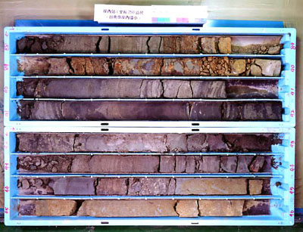
Core Sampling
Core sampling is one way that geologists determine the geologic formation of rocks and sediments when exploring for oil and gas.
Some students will hit rock and find it difficult to continue. Relate this to real-world drilling and why drill bits are used to churn up and break up rock in the sampling path.
This activity demonstrates the different ways sediments and rocks are formed in layers.

Slide 13
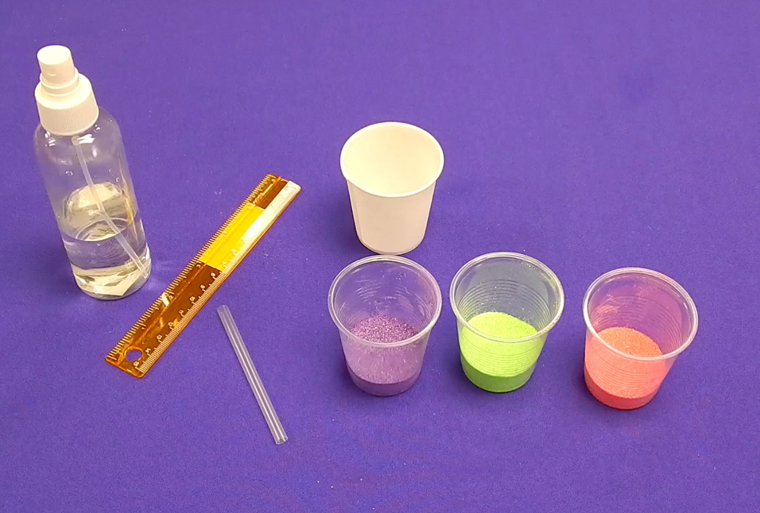
Core Sampling
Supplies
1 bag of dark sand*
1 bag of light sand
1 bag of soil
1 bag of small aquarium gravel
1 ruler
Water in a spray bottle
Plastic spoons
1 clear plastic cup per student
Clear plastic straws
Click on the image below to see the video

Slide 14
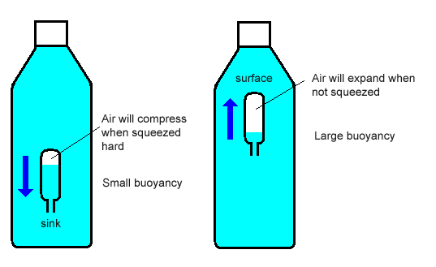
Cartesian Diver
Oil and gas separation technology makes use of density and buoyancy properties of materials. As the pressure declines in a reservoir, a gas cap is created.
This activity demonstrates that compressing material increases the material’s density.
Increasing the density then causes the “diver” to sink when it becomes more dense than the surrounding water. Releasing the pressure then causes the diver to float again.

Slide 15
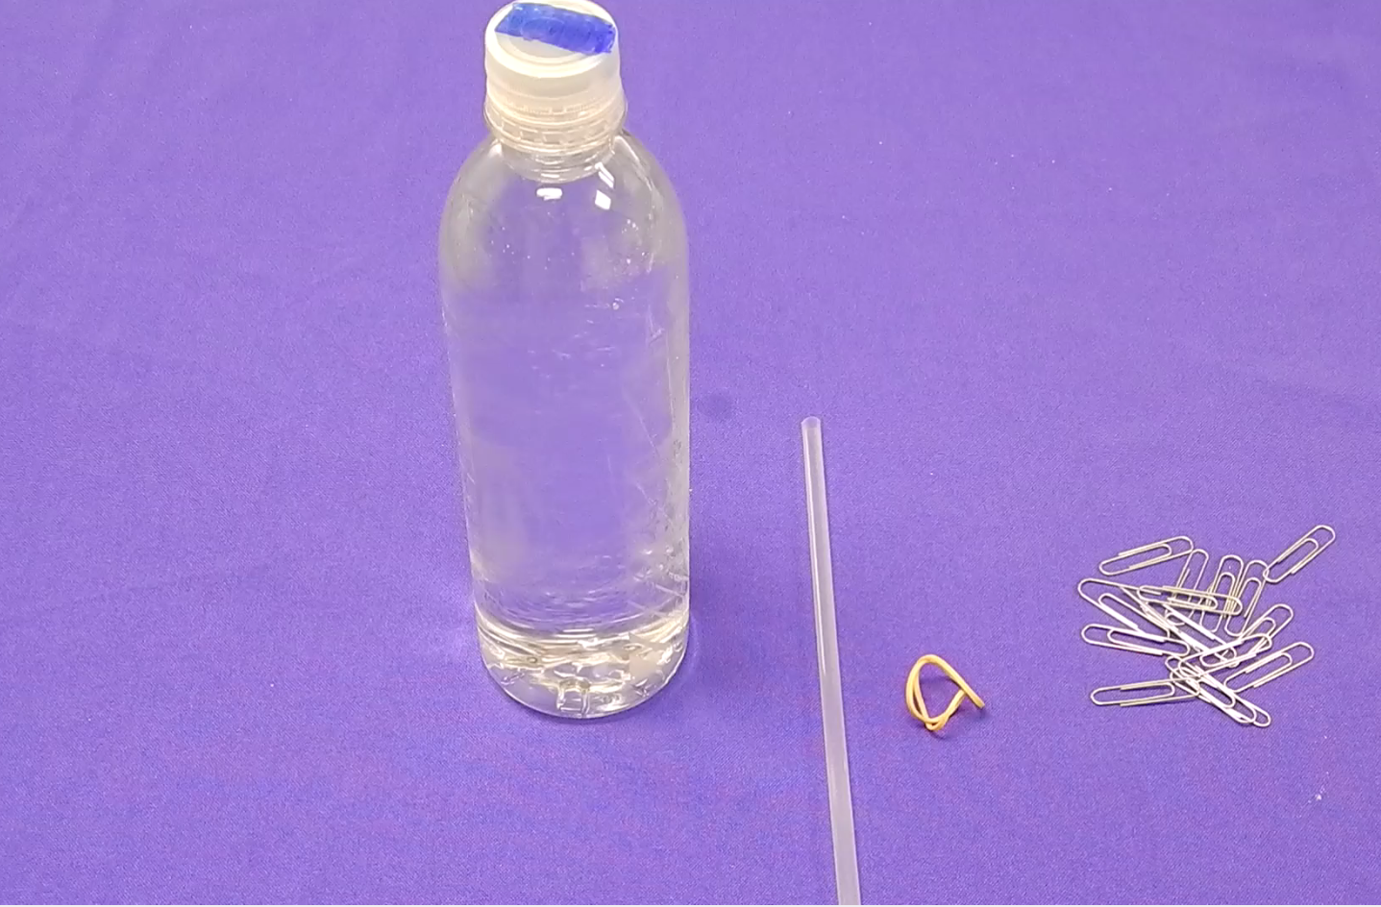
Cartesian Diver
Supplies
10 Large paper clips
1 Small rubber bands
1 Clear 500ml bottle with lid
1 Clear plastic straw
Click on the image below to see the video

Slide 16
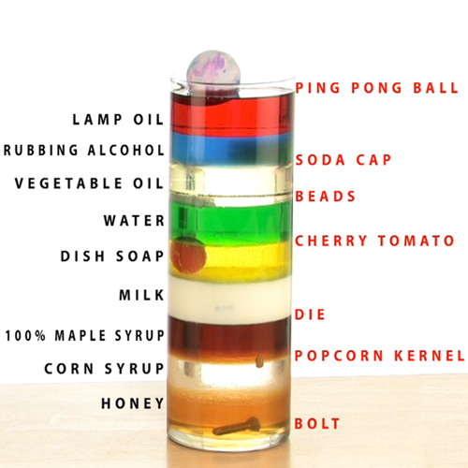
Understanding Density
Density is an important property in the formation of an oil and gas reservoir. Most reservoir rocks are porous and saturated with groundwater before oil or gas enters the rock.
Because groundwater is more dense, oil and gas is able to rise upward through the rock. The oil and gas continues to rise until trapped against an impermeable rock, or rock with spaces too small to move through, which creates a reservoir.
These reservoirs are then discovered by geologists and petroleum engineers and researched for production of the energy source.
This activity explores the property of density in a variety of liquids and solids. Discuss with students other liquids or objects they could test.

Slide 17
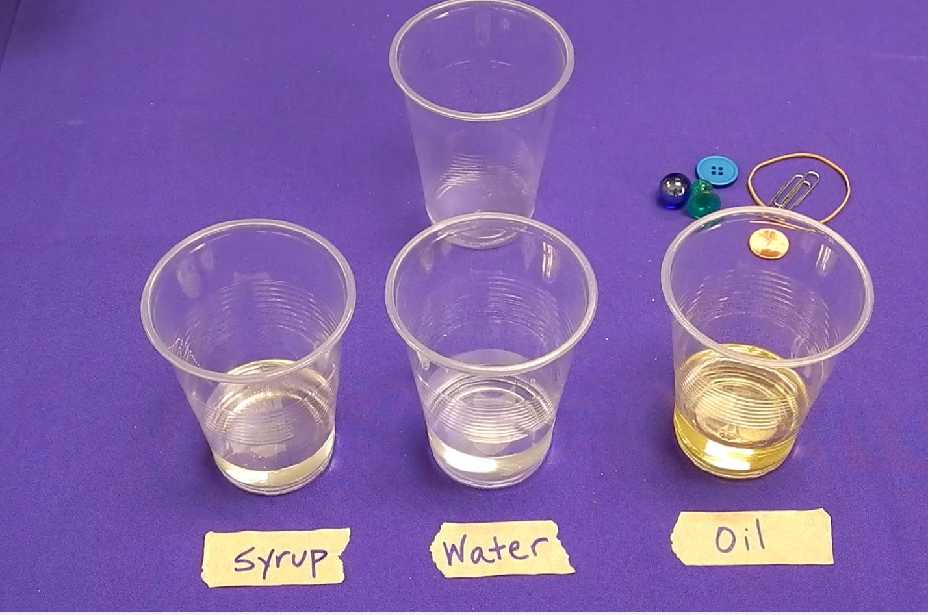
Understanding Density
Supplies
Clear cup
Corn syrup or honey
Water, can be dyed with food coloring
Choose 4-5 Objects such as:
Vegetable oil, button, coin, marble, wooden bead, ice cube
Click on the image below to see the video

Slide 18
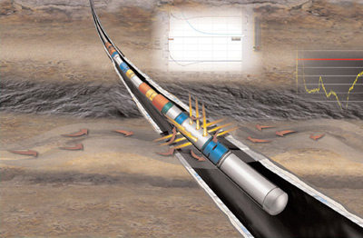
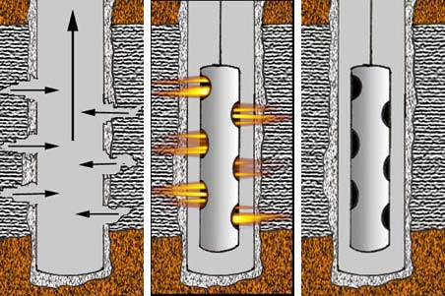
Perforated Well Casing
Petroleum engineers and geologists have developed technology to increase exposure of an oil and gas reservoir by drilling horizontally or at an angle. This method of drilling can produce three to five times more oil and gas than vertical drilling.
Perforation refers to a hole punched in the casing, or liner, of an oil well to connect it to a reservoir of oil or gas. These holes in the horizontal well casing allow oil and gas to flow easily into the wellbore, increasing production of a reservoir.
This activity models the differences in production of a perforated and non-perforated well casing. After the activity, discuss with students the model limitations and ways to improve the experiment.

Slide 19
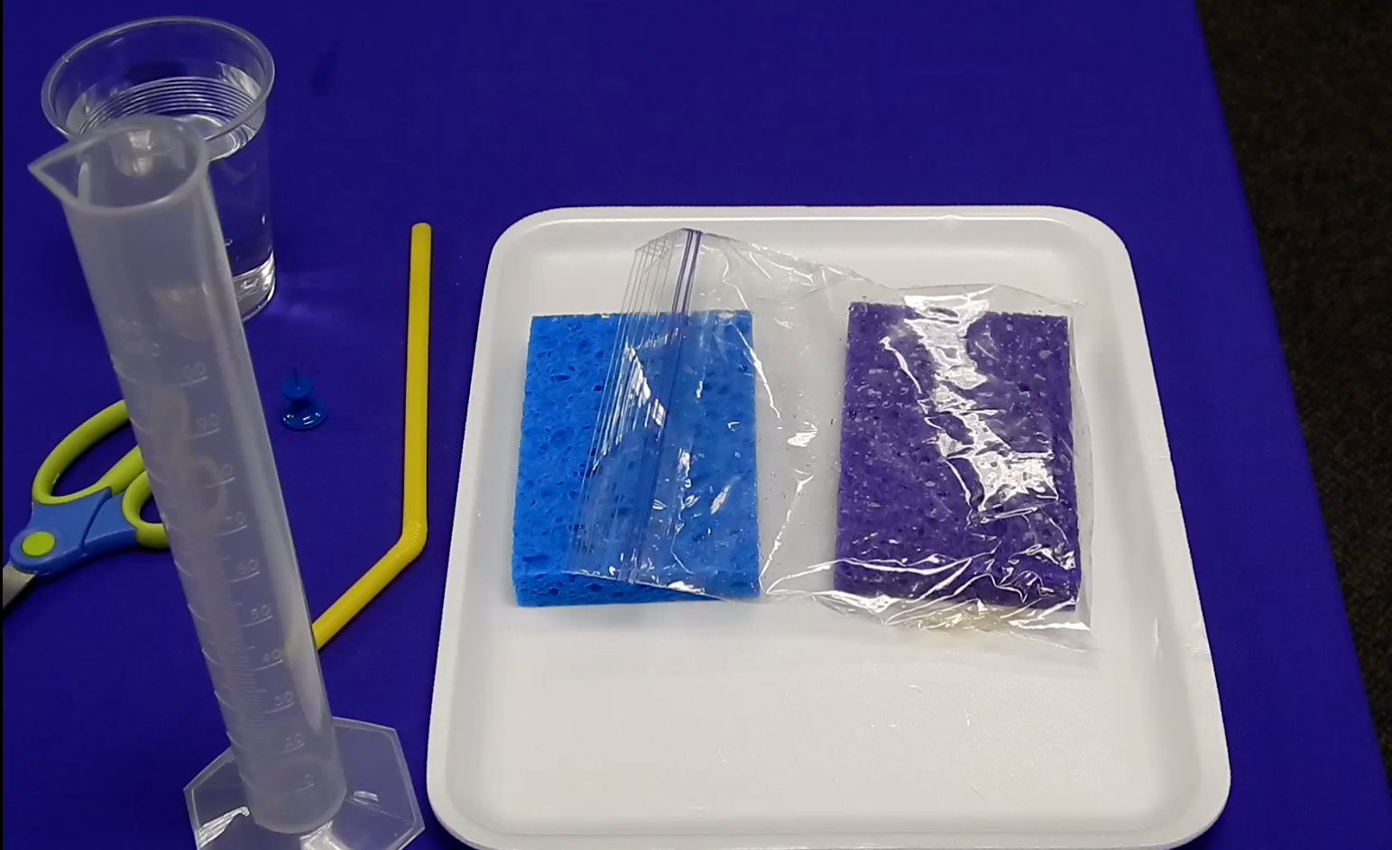
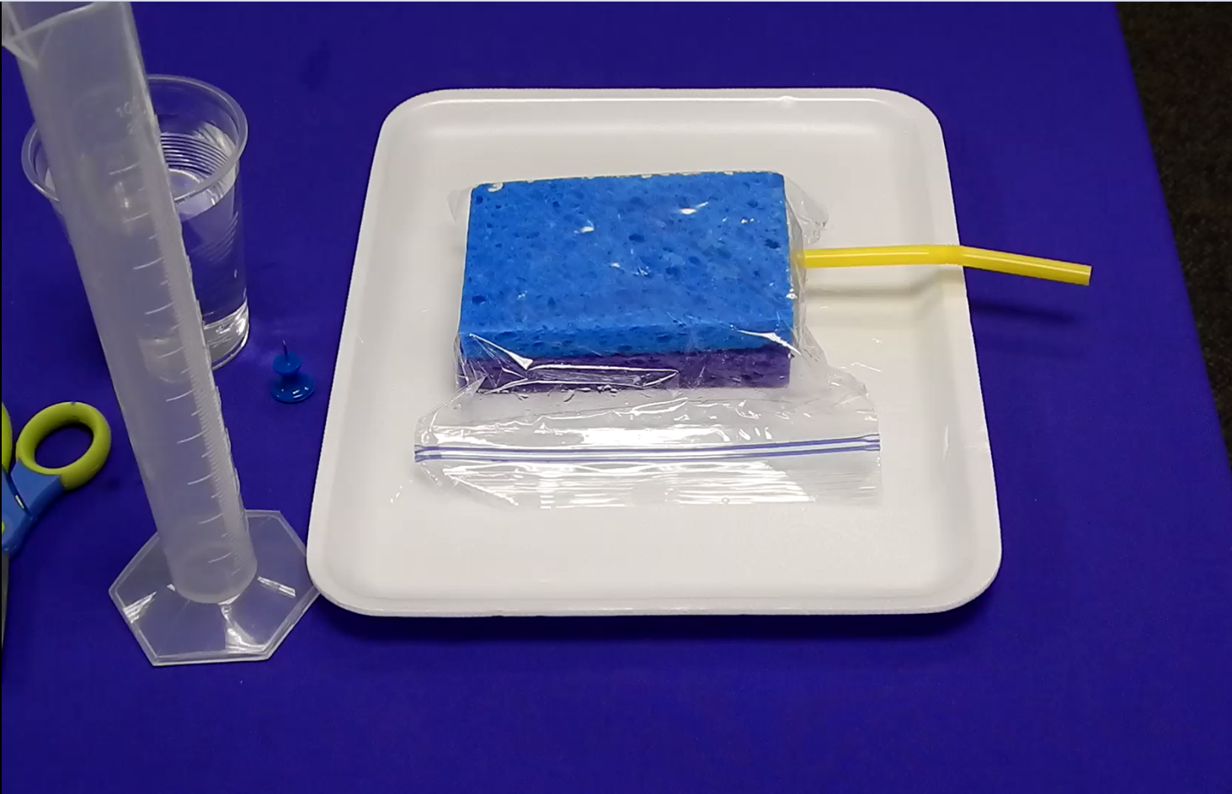
Perforated Well Casing
Click on the image below to see the video
Part I
Part II
Supplies
2 kitchen sponges, the same size and shape
Flexible straws
Pushpin
Shallow tray
Plastic wrap
100 ml graduated cylinders
Cup of water
Optional: Use a plastic sandwich bag and tape instead of the plastic wrap for the sponge setup

Slide 20
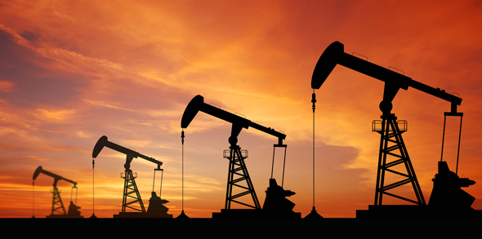
Getting the Oil Out
Oil, natural gas and saltwater are under extreme pressure below the surface trapped in reservoir rock.
These materials can flow up a well with or without assistance, depending on the properties of the well.
This activity demonstrates how artificial lift systems are used to help pull the oil out of the reservoir rock and pump it up the well.

Slide 21
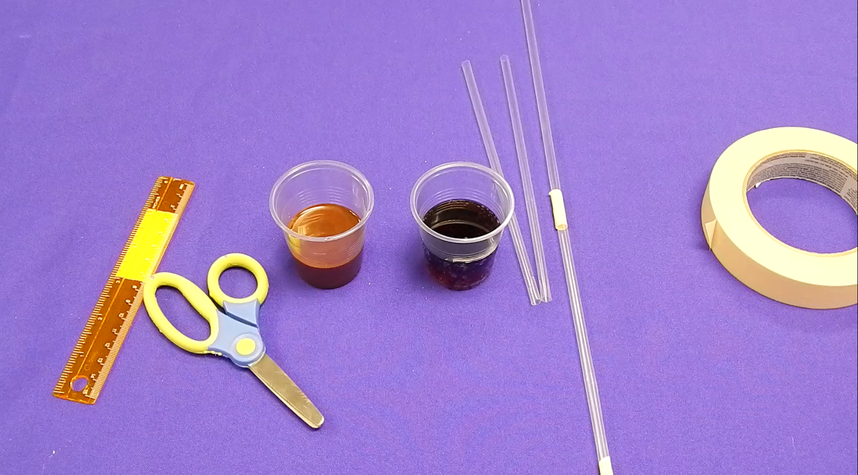
Getting the Oil Out
Supplies
8–10 drinking straws
Masking tape
Scissors
Small cups
Choose two liquids to compare: dark soda*, chocolate syrup*, chocolate milk, pancake syrup or honey
*preferred to also demonstrate viscosity of liquids
Click on the image below to see the video

